Slide 1
Laboratory work 1
By Yusup Abylaikhan

Slide 2
1. Entities
AIRPORT, AIRLINE, FLIGHT, PASSENGER, BOOKING, BOOKING_HISTORY, BOARDING_PASS, BAGGAGE, BAGGAGE_CHECK, SECURITY_CHECK.

Slide 3
2. Attributes
AIRPORT
AIRLINE
Attribute | Type | Constraint
airport_id | INT | PK
airport_name | VARCHAR(100) | NOT NULL
country | VARCHAR(60) | NOT NULL
state | VARCHAR(60) | NULL
city | VARCHAR(60) | NOT NULL
Attribute | Type | Constraint
airline_id | INT | PK
airline_code | CHAR(3) | UNIQUE, NOT NULL
name | VARCHAR(100) | NOT NULL
country | VARCHAR(60) | NOT NULL

Slide 4
FLIGHT
Attribute | Type | Constraint
flight_id | INT | PK
airline_id | INT | FK → AIRLINE, NOT NULL
departure_airport_id | INT | FK → AIRPORT, NOT NULL
arrival_airport_id | INT | FK → AIRPORT, NOT NULL, CHECK ≠ departure_airport_id
departing_gate | VARCHAR(10) | NULL
arriving_gate | VARCHAR(10) | NULL
scheduled_departure | TIMESTAMP | NOT NULL
scheduled_arrival | TIMESTAMP | NOT NULL, CHECK > scheduled_departure
actual_departure | TIMESTAMP | NULL
actual_arrival | TIMESTAMP | NULL

Slide 5
PASSENGER
Attribute | Type | Constraint
passenger_id | INT | PK
first_name | VARCHAR(50) | NOT NULL
last_name | VARCHAR(50) | NOT NULL
gender | CHAR(1) | NOT NULL
date_of_birth | DATE | NOT NULL
citizenship_country | VARCHAR(60) | NOT NULL
residence_country | VARCHAR(60) | NOT NULL
passport_number | VARCHAR(20) | UNIQUE, NOT NULL

Slide 6
BOOKING
Attribute | Type | Constraint
booking_id | INT | PK
flight_id | INT | FK → FLIGHT, NOT NULL
passenger_id | INT | FK → PASSENGER, NOT NULL
status | VARCHAR(20) | NOT NULL
booking_platform | VARCHAR(50) | NOT NULL
ticket_price | DECIMAL(10,2) | NOT NULL, CHECK ≥ 0
BOOKING_HISTORY
Attribute | Type | Constraint
history_id | INT | PK
booking_id | INT | FK → BOOKING, NOT NULL
old_flight_id | INT | FK → FLIGHT, NOT NULL
new_flight_id | INT | FK → FLIGHT, NOT NULL
old_status | VARCHAR(20) | NOT NULL
new_status | VARCHAR(20) | NOT NULL
changed_at | TIMESTAMP | NOT NULL

Slide 7
BOARDING_PASS
Attribute | Type | Constraint
boarding_pass_id | INT | PK
booking_id | INT | FK → BOOKING, UNIQUE, NOT NULL
seat | VARCHAR(4) | NOT NULL
boarding_time | TIMESTAMP | NOT NULL
BAGGAGE
Attribute | Type | Constraint
baggage_id | INT | PK
booking_id | INT | FK → BOOKING, NOT NULL
weight_kg | DECIMAL(5,2) | NOT NULL, CHECK > 0

Slide 8
BAGGAGE_CHECK
Attribute | Type | Constraint
baggage_check_id | INT | PK
baggage_id | INT | FK → BAGGAGE, NOT NULL
booking_id | INT | FK → BOOKING, NOT NULL
passenger_id | INT | FK → PASSENGER, NOT NULL
check_result | VARCHAR(20) | NOT NULL
SECURITY_CHECK
Attribute | Type | Constraint
security_check_id | INT | PK
passenger_id | INT | FK → PASSENGER, NOT NULL
check_result | VARCHAR(20) | NOT NULL

Slide 9
3. Relationships
Parent | Child | Cardinality | Participation
AIRPORT (departure) | FLIGHT | 1 : N | Airport partial, flight total
AIRPORT (arrival) | FLIGHT | 1 : N | Airport partial, flight total
AIRLINE | FLIGHT | 1 : N | Airline partial, flight total
FLIGHT | BOOKING | 1 : N | Flight partial, booking total
PASSENGER | BOOKING | 1 : N | Passenger partial, booking total
BOOKING | BOOKING_HISTORY | 1 : N | Booking partial, history total
BOOKING | BOARDING_PASS | 1 : 1 | Booking partial, pass total
BOOKING | BAGGAGE | 1 : N | Booking partial (baggage optional), baggage total
BAGGAGE | BAGGAGE_CHECK | 1 : N | Baggage partial, check total
BOOKING | BAGGAGE_CHECK | 1 : N | Booking partial, check total
PASSENGER | BAGGAGE_CHECK | 1 : N | Passenger partial, check total
PASSENGER | SECURITY_CHECK | 1 : N | Passenger partial, check total

Slide 10
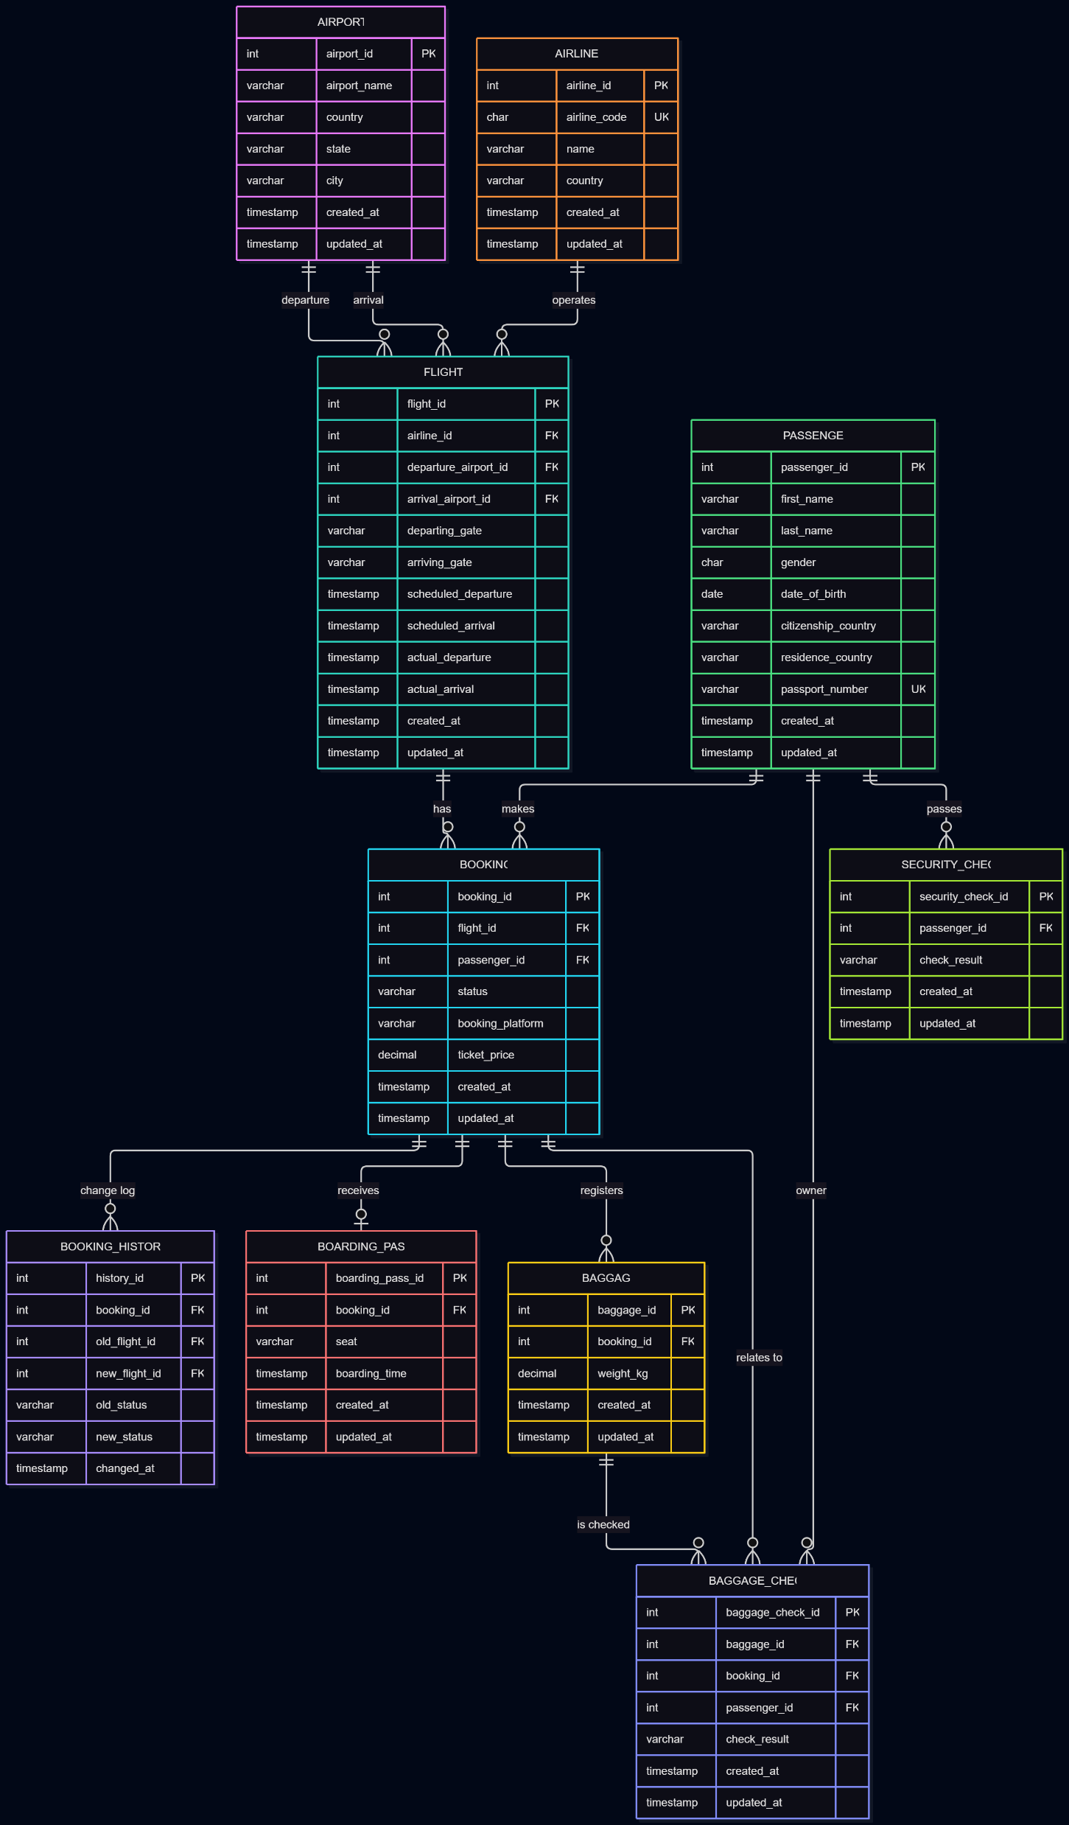
4. Diagram

Slide 11
5. Legend
Symbol | Meaning
PK | Primary key
FK | Foreign key
UK | Unique key
|| | Exactly one (mandatory)
o| | Zero or one
o{ | Zero or many
Solid line | Identifying link via foreign key in the child entity

